Slide 1




OPTIMIZED SKILL ENDORSEMENT WEB BASED SOLUTION FOR THE ENTERTAINMENT INDUSTRY.​
TMP-2023-24-109

Slide 2

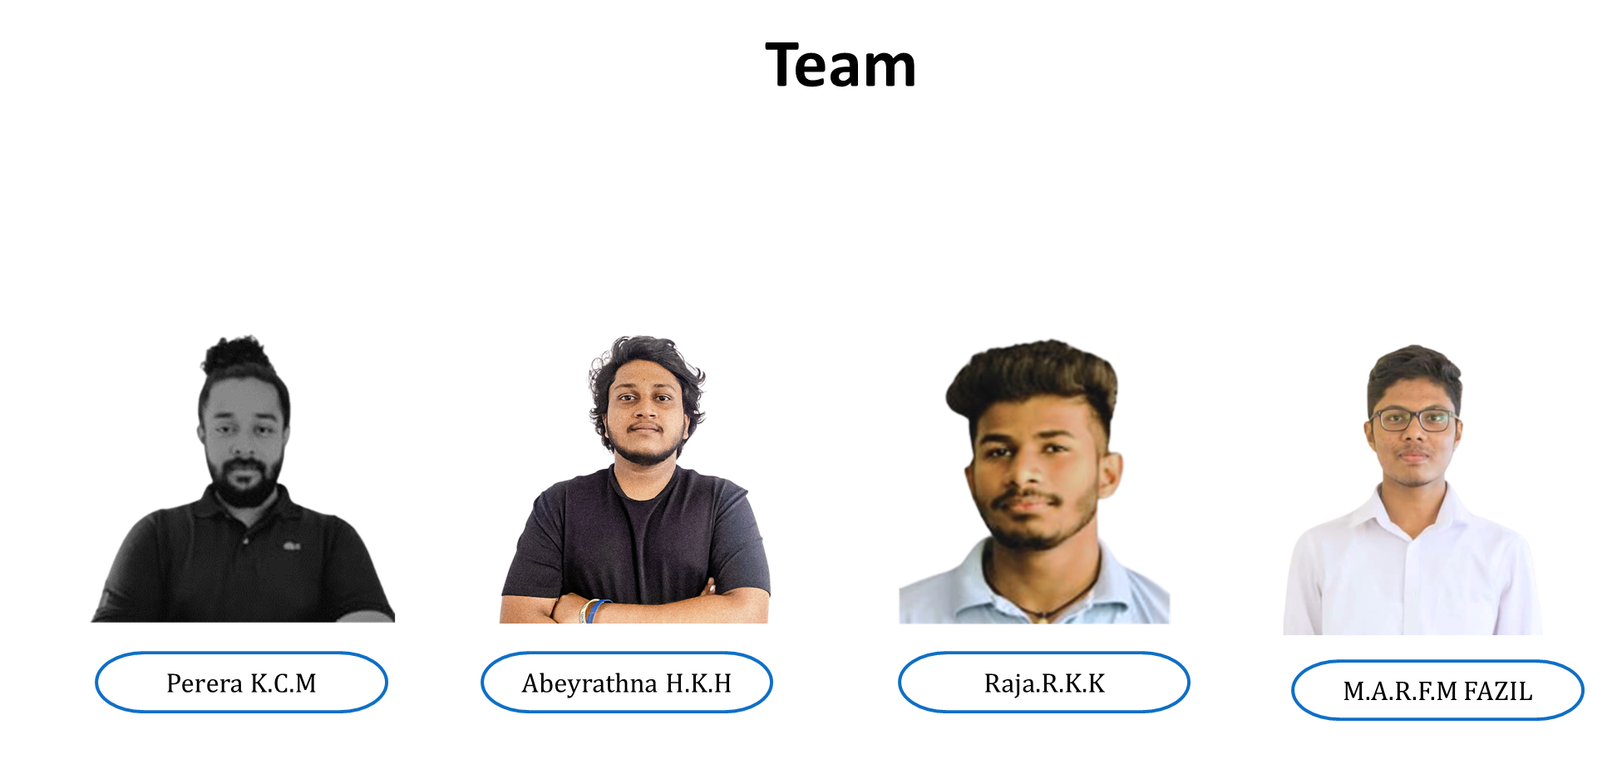
Team members
IT20638504
IT20166274
IT20667146
IT20050962
Perera K.C.M

Slide 3



Introduction
What is Cine-Collab?
What are the problems of existing platforms ?​
How talents find opportunities

Slide 4
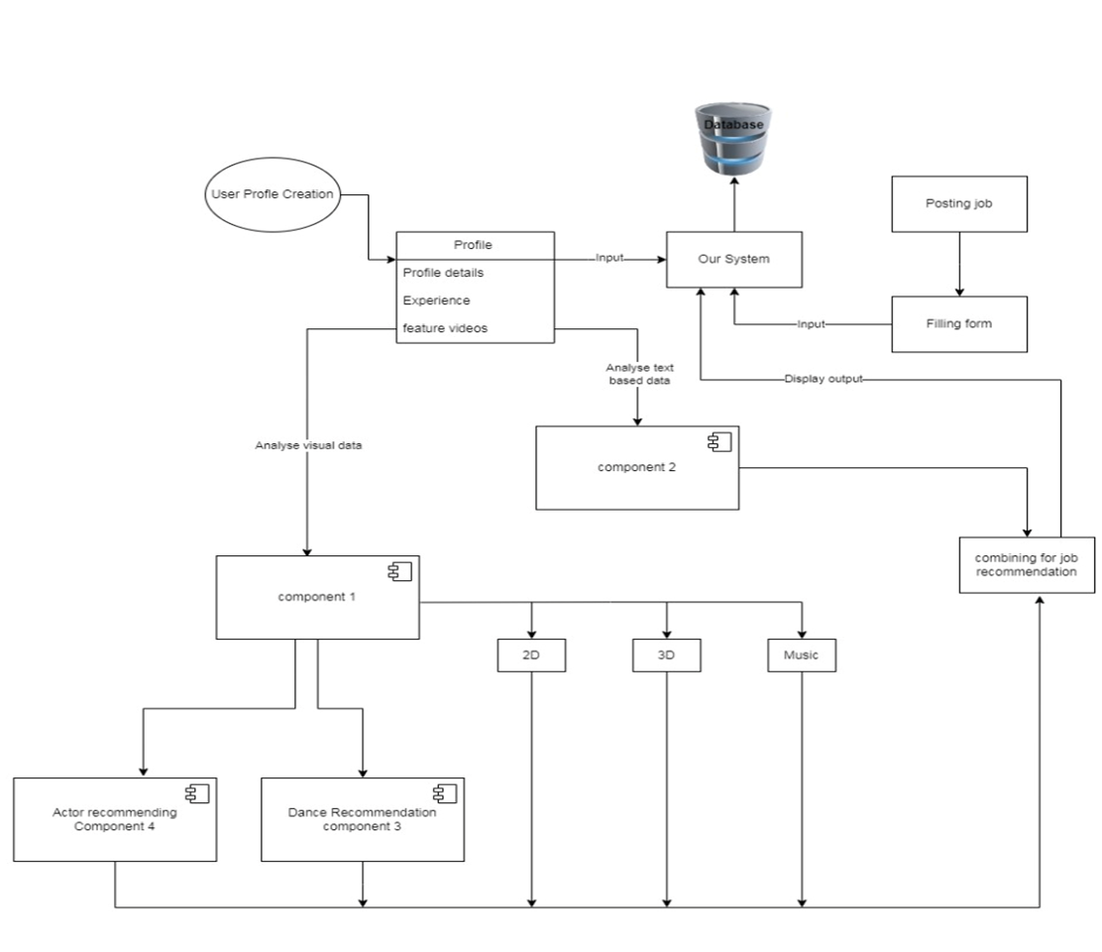
Overall system architecture diagram

Slide 5


Video classification & job recommendation
IT20638504 | Perera K.C.M
Bachelor of Science (Hons) in Information Technology Specializing in Interactive Media​

Slide 6
Used Technologies
Tools:
Machine learning – Python
Version Controlling – Git Hub
For implementation - Google collab
Front end – React JS
Database - mongo DB
Specific Objective:
keras
Video processing – Open CV

Slide 7
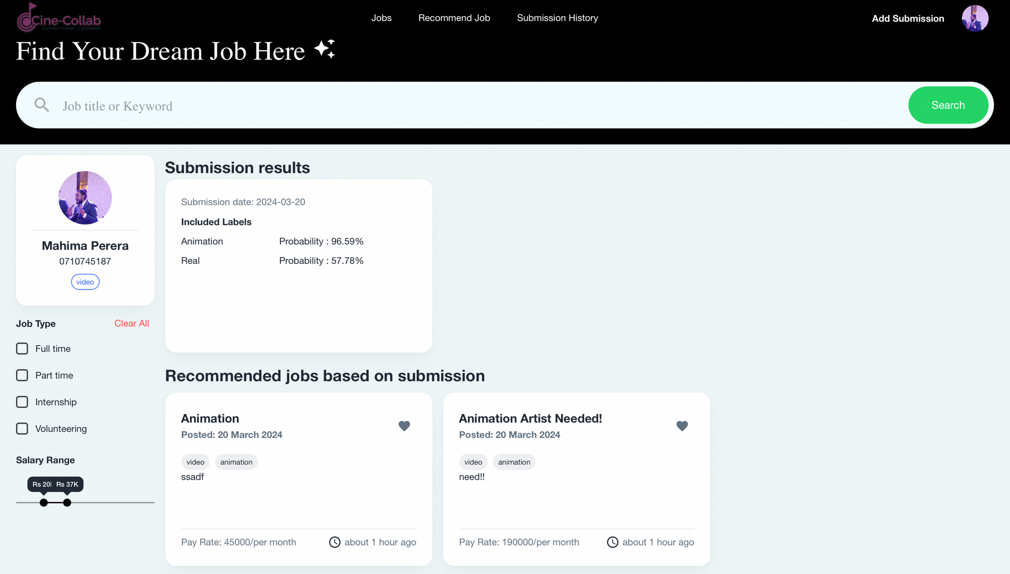
Video classification & job recommendation

Slide 8
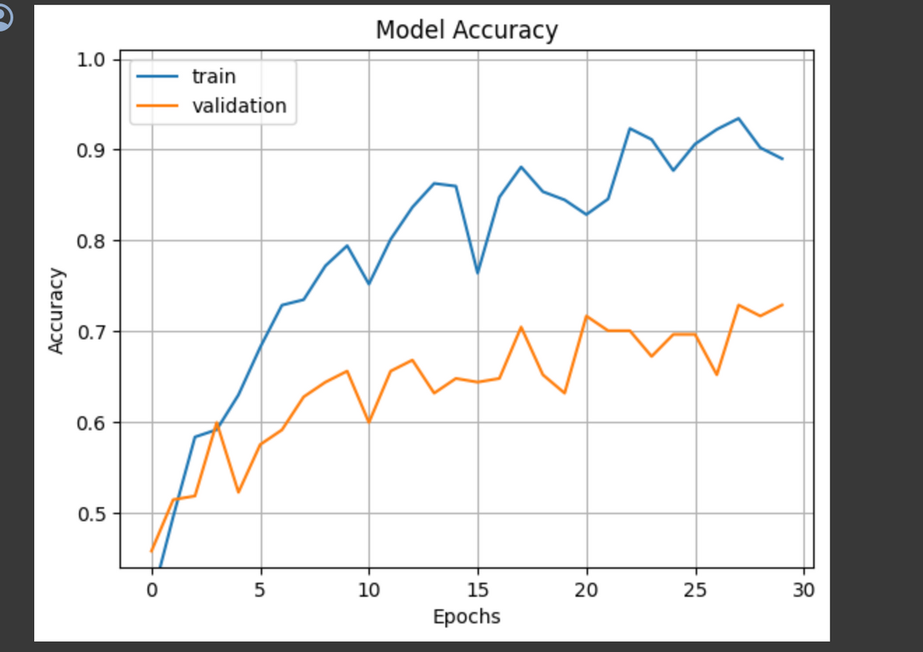
Accuracy Calculation

Slide 10
Specific and Sub Objectives​
Video classification and job recommendation system to classifying similarities, types (3D, vfx , Live) between uploaded videos/images by the user and recommend the best match.

Slide 11

Methodology
•Data Collection
•Training the model to get the most accurate output
•User Interface and Database Development
•Testing User Feedback, and Updates
​

Slide 12
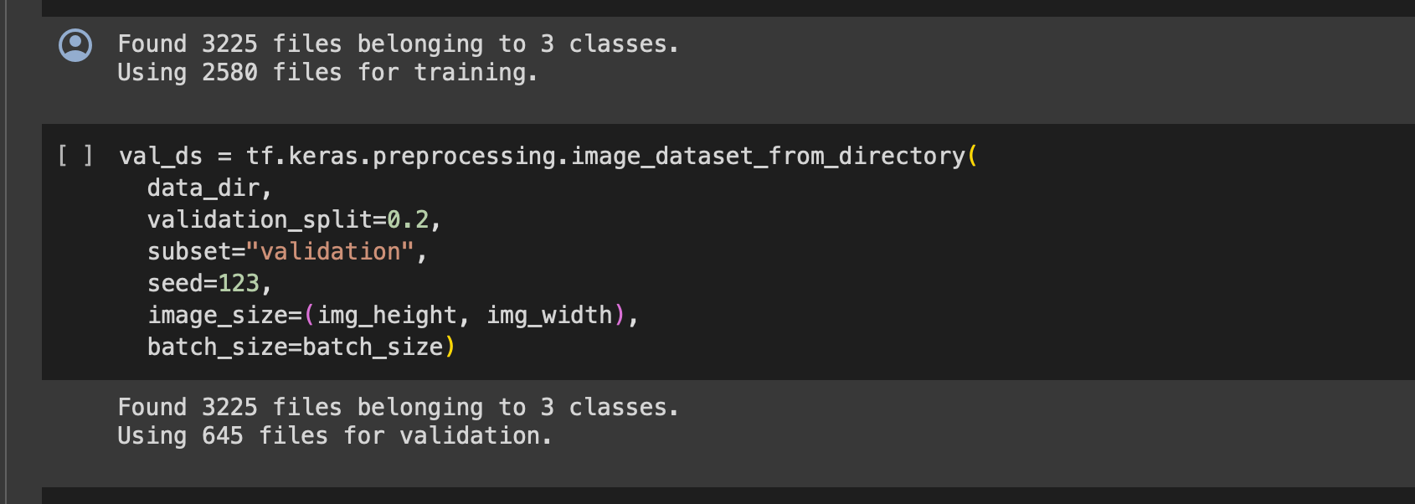
Trained Data set

Slide 13

Role Based Classification
IT20166274 | Abeyrathna H.K.H
Bachelor of Science (Hons) in Information Technology Specializing in Interactive Media​
Abeyrathna H.K.H
IT20166274

Slide 14
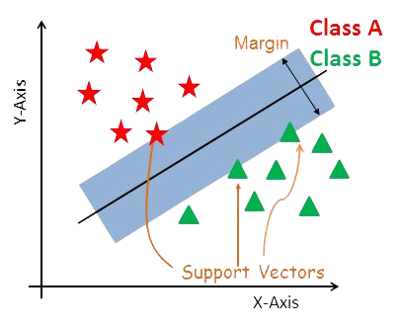

Used Technologies
Support Vector Machine (SVM)
Support Vector Machine (SVM) is a powerful machine learning algorithm used for linear or nonlinear classification, regression, and even outlier detection tasks. SVMs can be used for a variety of tasks, such as text classification.
Sklearn- Libraries
Pandas
Mongo DB
Mern Stack
Python
javascript

Slide 15
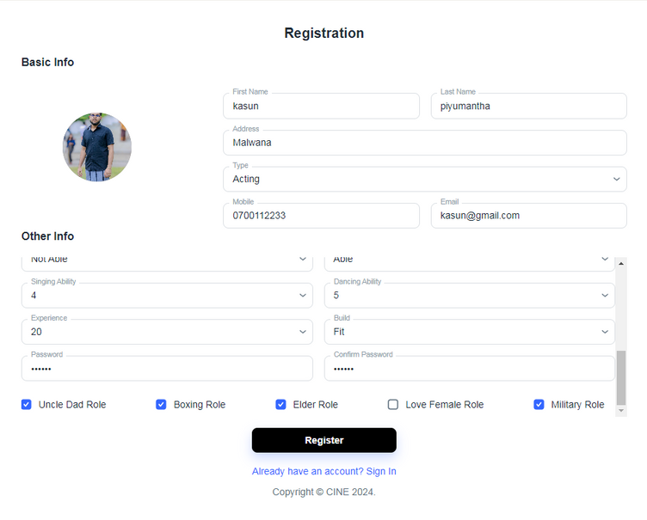
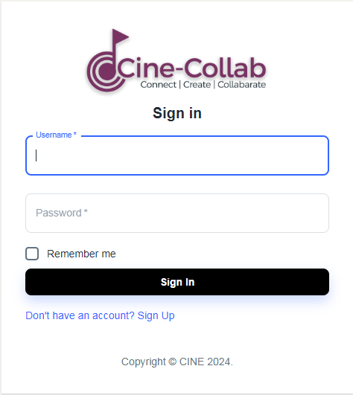
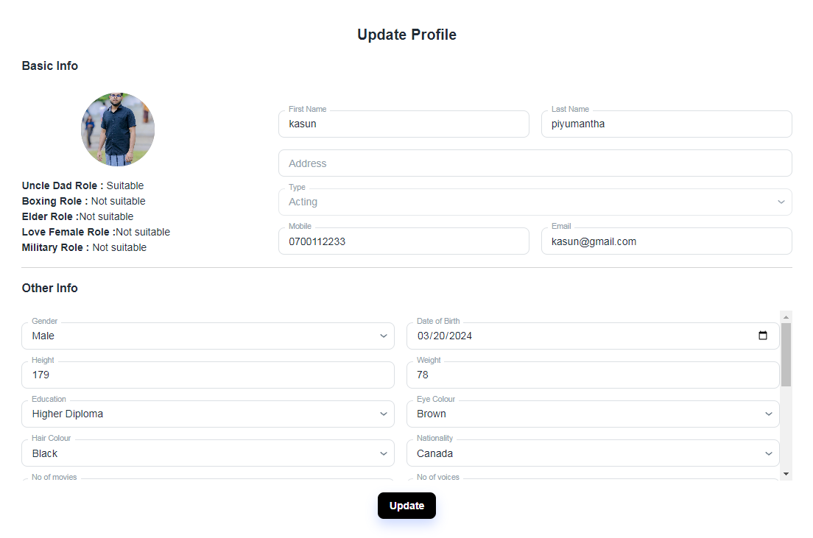
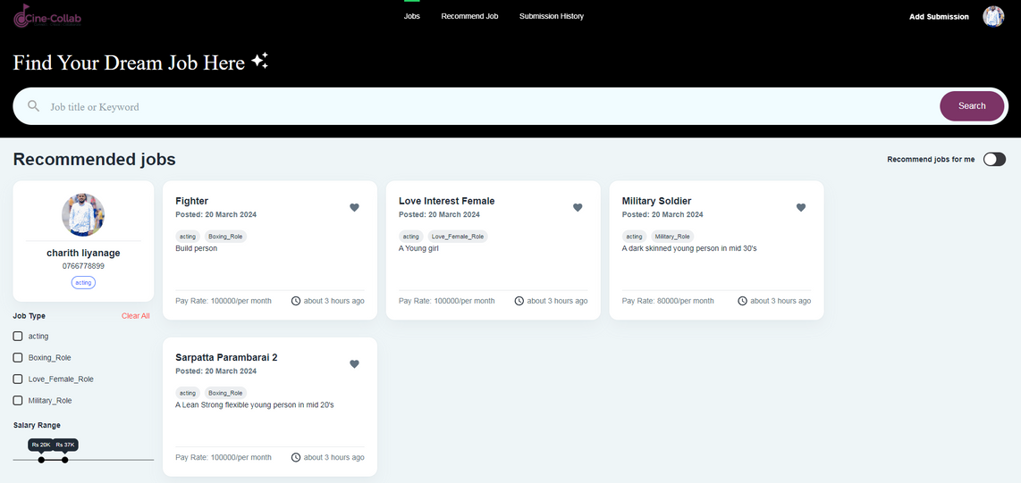

Sign up
Log in
Role classification
If there's a
recommended job It can see when click this button

Slide 16
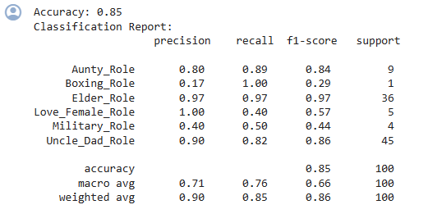
Accuracy Calculation

Slide 17
Accuracy Calculation

Slide 18
Dance Demo Video Uploading and Similarity Identification
IT20667146 | RAJA.R.K.K
Bachelor of Science (Hons) in Information Technology Specializing in Interactive Media​

Slide 19
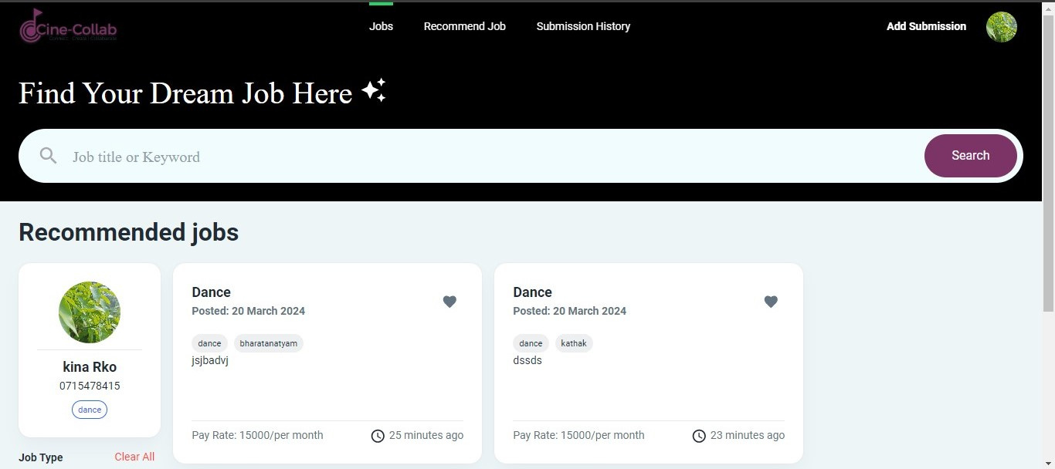
Dance Demo video Uploading
similarity Uploading

Slide 20
Used Technologies
Mongo DB
Mern Stack
Python
javascript
AWS
Resnet
React js - Frondend

Slide 21
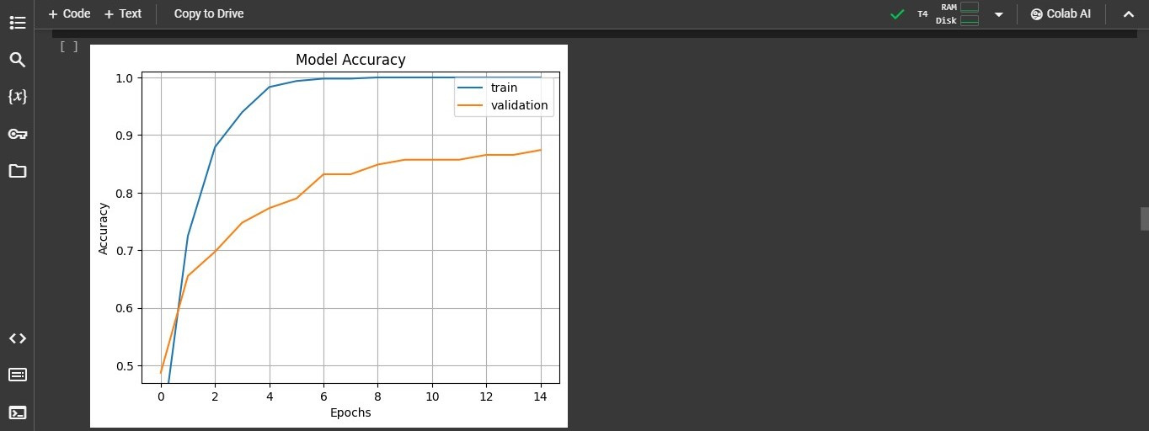
Accuracy Calculation

Slide 22
Specific and Sub Objectives​
Track the similarity between the original demo video and
the dance​ videos submitted by job applicants.​
​
Utilization of video analysis techniques and machine learning
algorithms to compare.

Slide 23
Methodology
Filtering Similar role ​
Machine learning algorithms to compare dance movements​
Training and Dataset Preparation​
​

Slide 24
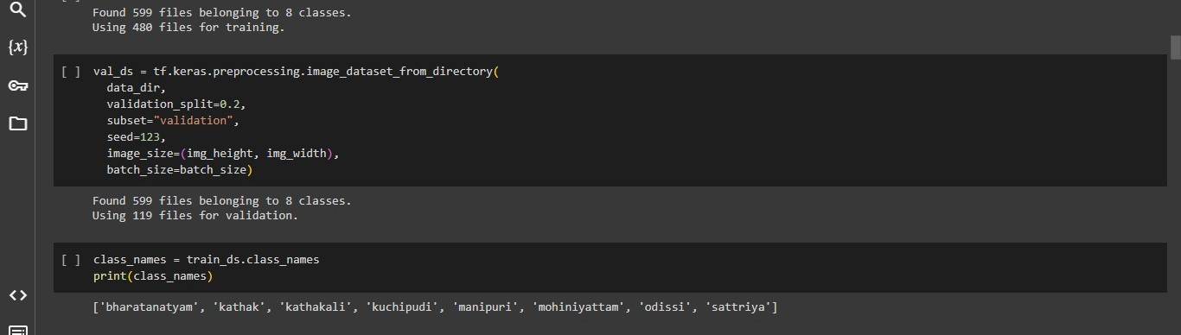
Train Data set

Slide 25
Classifying roles for Acting and Job recommendation
IT20050962 | M.A.R.F.M FAZIL
Bachelor of Science (Hons) in Information Technology Specializing in Interactive Media​

Slide 26
Background study
Difficulty in Finding Talents for Acting​
Lengthy and Manual Casting Process​
Difficulty in Finding Opportunities for Acting​
​
Lack of Collaboration among Aspiring Creators

Slide 27

Research Problem
Film industry challenges in regions like Sri Lanka
Proposed solution: A tech-based platform for personalized job recommendations

Slide 28
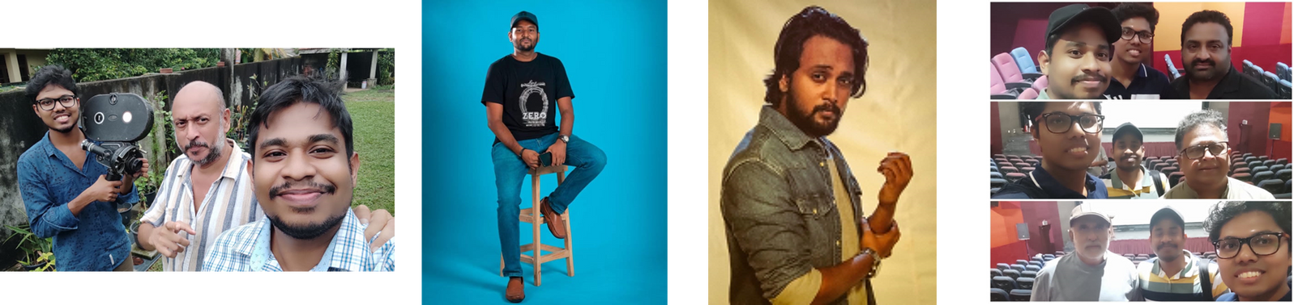
Research and Background Guidance
Gorden De Silva
Director & Cinematographer
(Rupawahini)
Abishek Palraj
Film maker&
Cinematographer
(Independent)
Gorden De Silva
Actor & TV host
(Maharaja Network)

Slide 29
Objectives
Classifying roles for Acting and Job recommendation​
​
Specific Objective:​
Enhancing Casting Process Efficiency
​Job Recommendation for Actors using Image/Video-Based Approach​
Advance machine learning Algorithms​

Slide 30
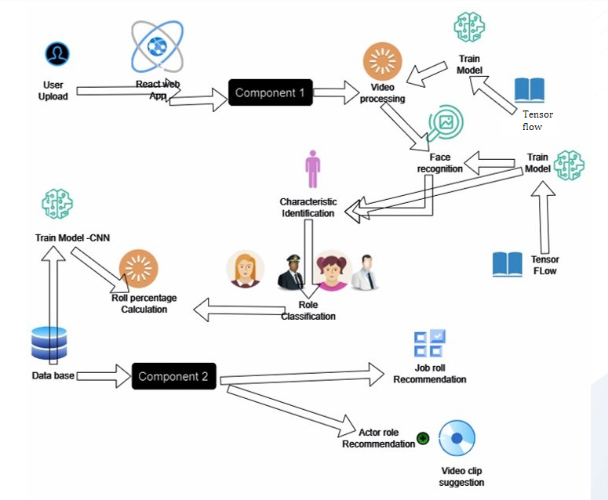
System Diagram

Slide 31




Current Progress
Increased the dataset from 2500 to 7000 and increased the Accuracy
Tried Mobilenet , VGG19 models for comparision
Created User interface and Recommendation
Hosting
90%

Slide 32
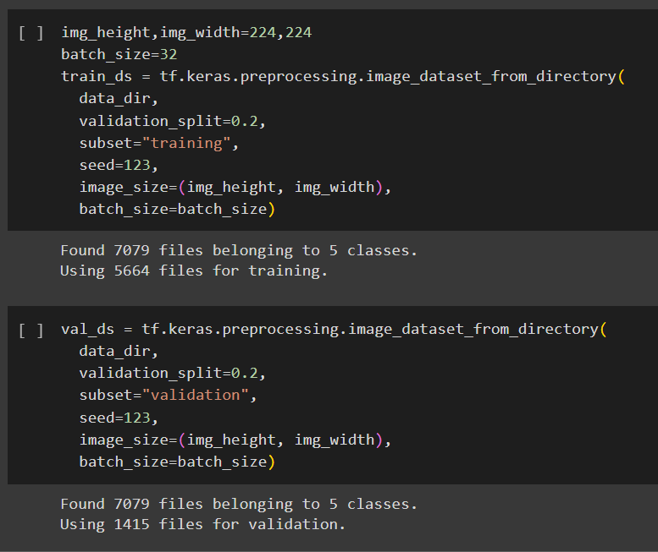
Test Results

Slide 33
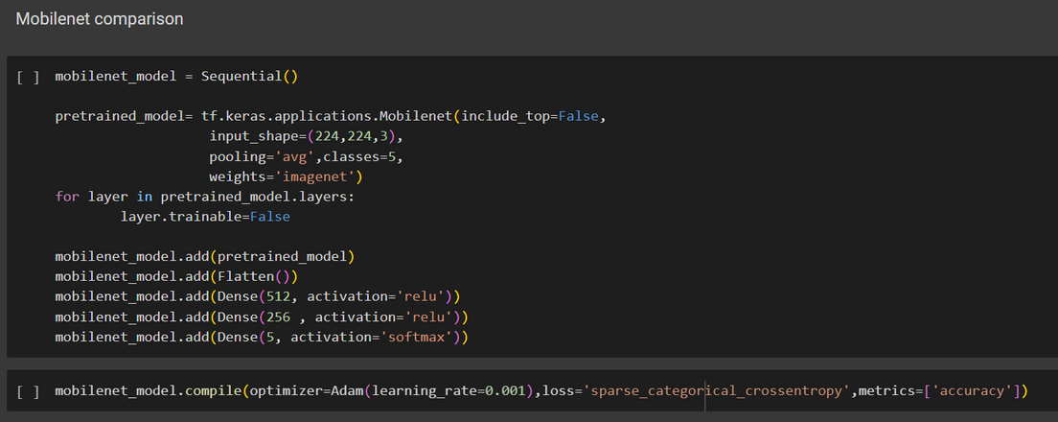
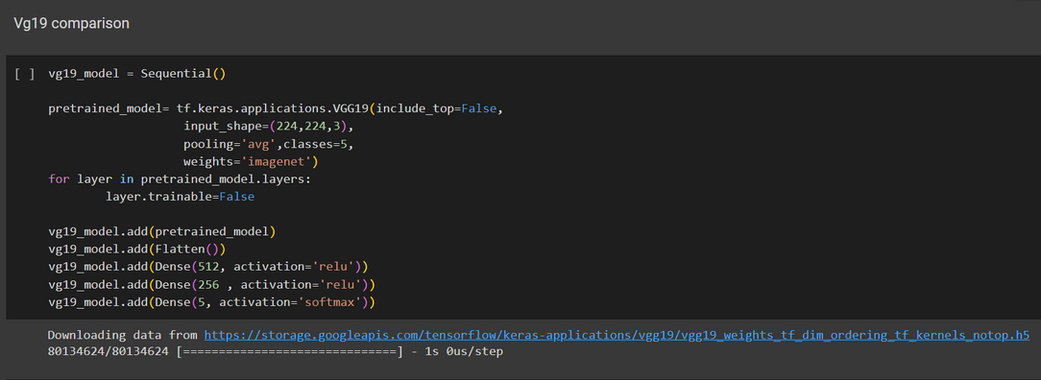
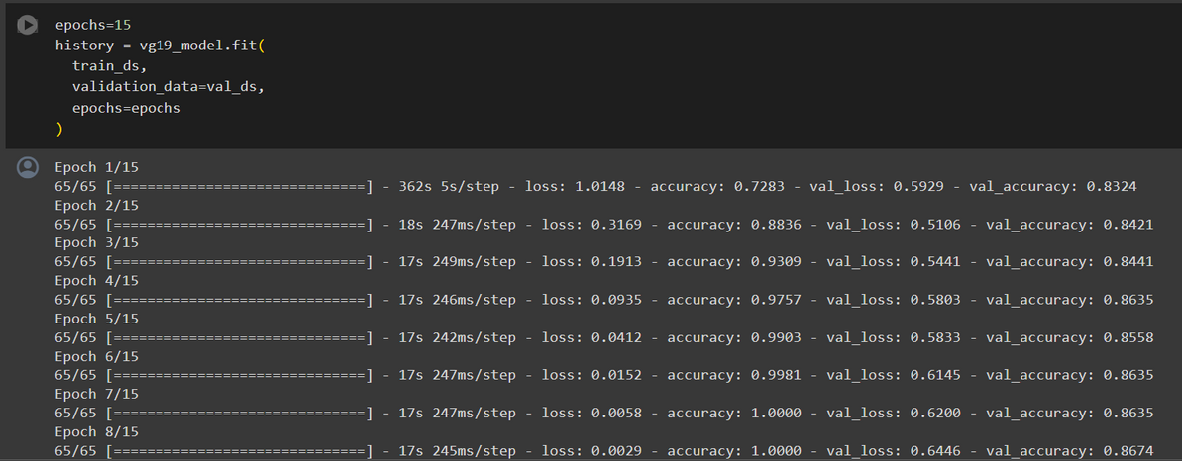
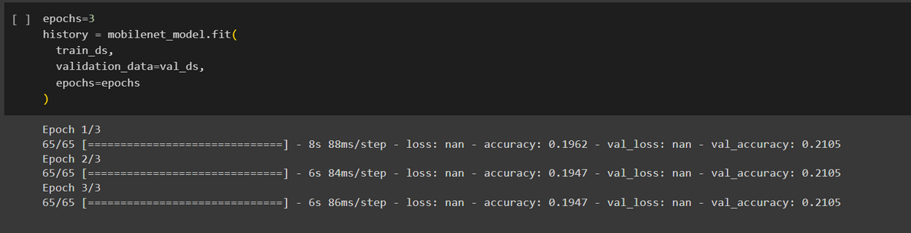
Training Model Comparison

Slide 34
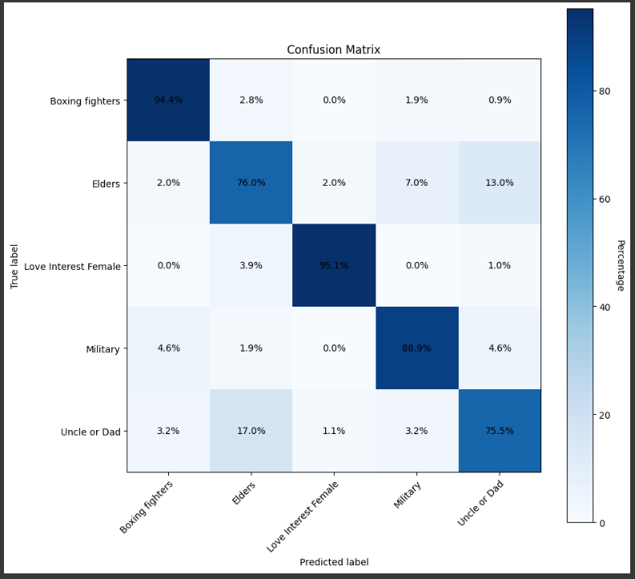
Confusion Matrix

Slide 35
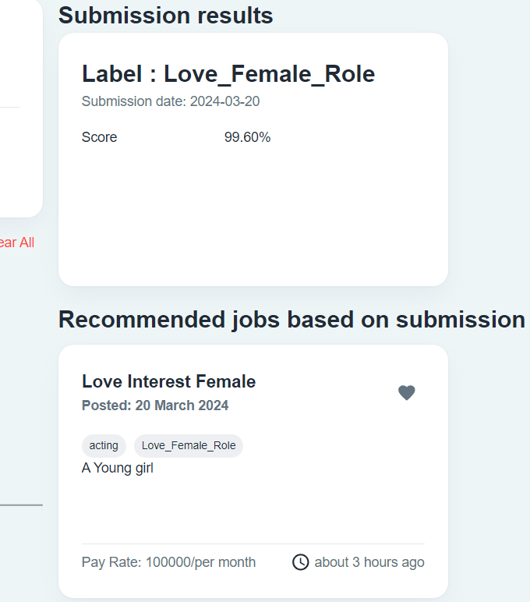
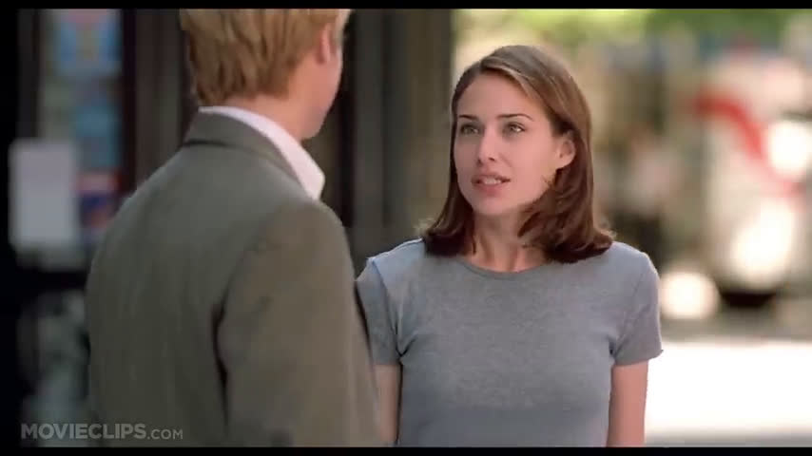
Add Submission

Slide 36
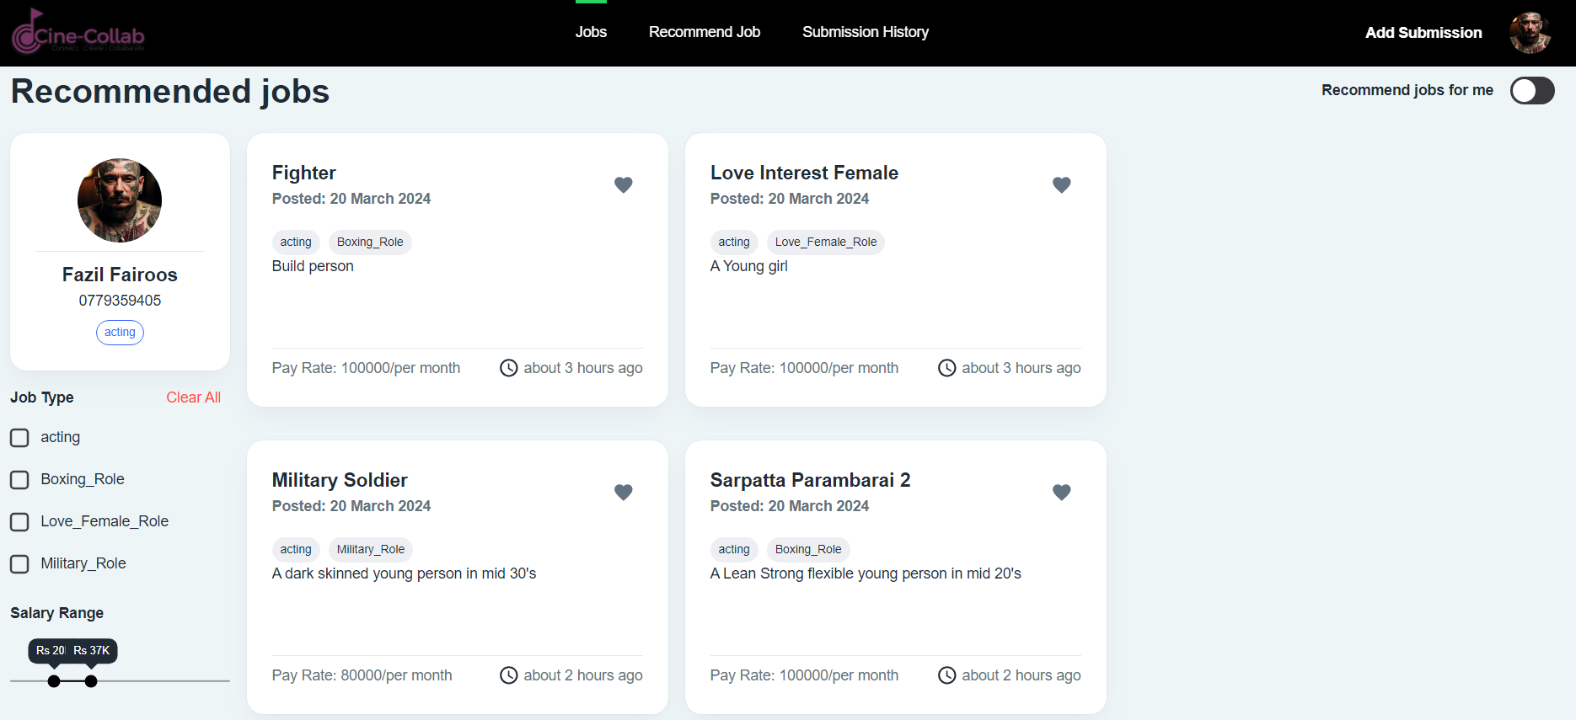
Submissions

Slide 37

Expected Future Progress
Storage Implementation
Fine tuning user interfaces
Add a Face recognition Api

Slide 38
Ability to Commercialization
Create a cast recommendation system for the entertainment industry.
Expand for commercial use, including recruiter recommendations for efficiency

Slide 39
THANK YOU
For watching this presentation

